Slide 1
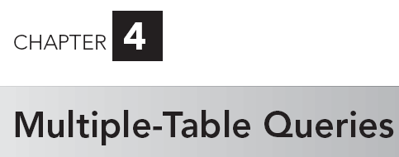
5
A Guide to MySQL

Slide 2
Objectives
Use joins to retrieve data from more than one table
Use the IN and EXISTS operators to query multiple tables
Use a subquery within a subquery
Use an alias

Slide 3
Objectives
Join a table to itself
Perform set operations (union, intersection, and difference)
Use the ALL and ANY operators in a query
Perform special operations (inner join, outer join, and product)

Slide 4
Querying Multiple Tables
Retrieve data from two or more tables:
  Join tables
  Use same commands as for single-table queries

Slide 5
Joining Two Tables
SELECT clause: list all columns to display
FROM clause: list all tables involved in query
WHERE clause: restrict to rows that have common values in matching columns

Slide 6
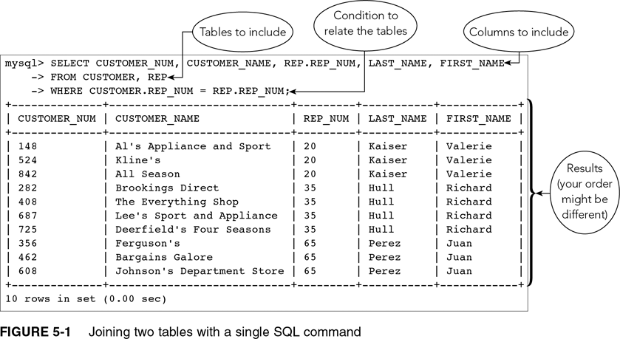
Joining Two Tables (continued)

Slide 7
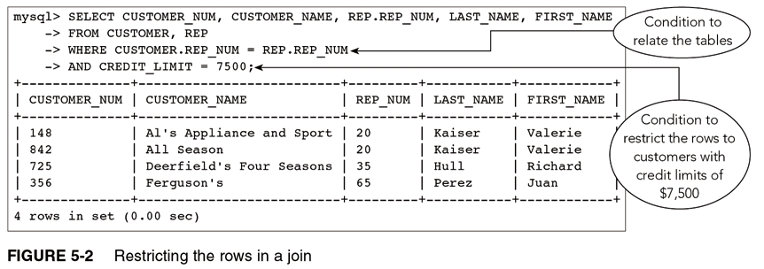
Joining Two Tables (continued)

Slide 8
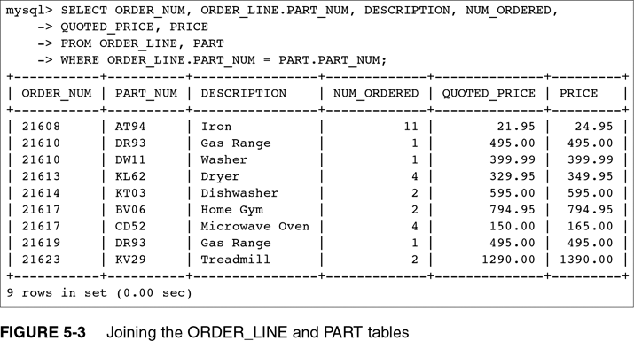
Joining Two Tables (continued)

Slide 9
Comparing JOIN, IN, and EXISTS
Use WHERE clause
Use IN operator with a subquery
Use EXISTS operator with a subquery

Slide 10
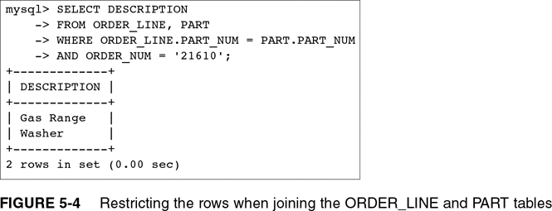
Comparing JOIN, IN, and EXISTS (continued)

Slide 11
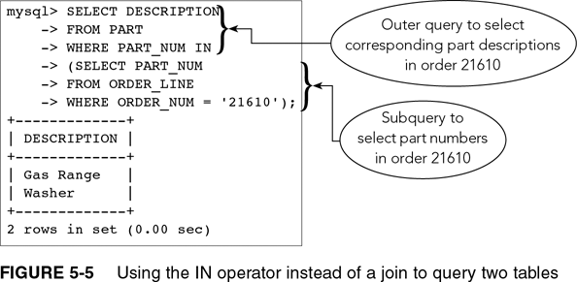
Using the IN Operator

Slide 12
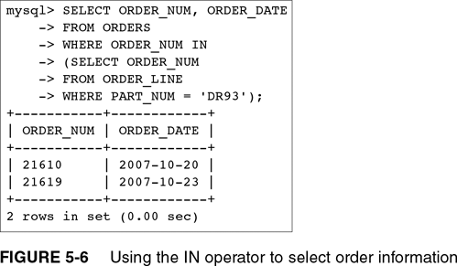
Using the EXISTS Operator

Slide 13
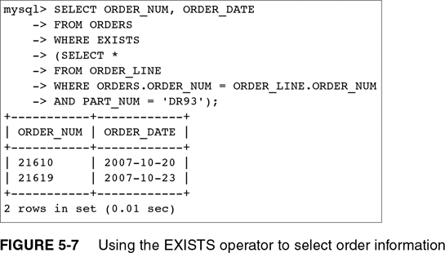
Using the EXISTS Operator (continued)

Slide 14
Correlated Subquery
Subquery involves a table listed in outer query
In Figure 5-7 the ORDERS table, listed in FROM clause of outer query used in subquery
Must qualify ORDER_NUM column in subquery as ORDERS.ORDER_NUM

Slide 15
Using a Subquery Within a Subquery
Nested subquery: subquery within a subquery
Evaluate from innermost query to outermost
More than one approach to formulating queries
Many DMBS have optimizers that analyze queries for efficiency
Subqueries available in MySQL 4.1 and higher

Slide 16
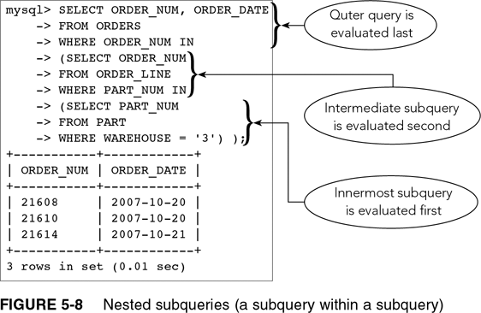
Using a Subquery Within a Subquery (continued)

Slide 17
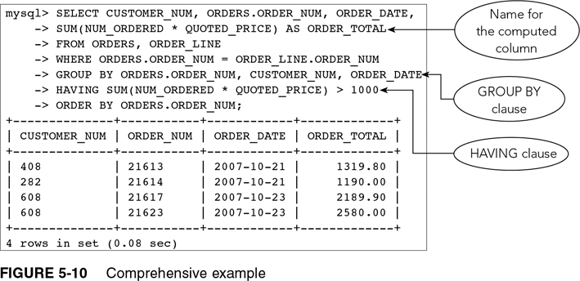
A Comprehensive Example

Slide 18
Using an Alias
An alternate name for a table
Use in FROM clause
Type name of table, press Spacebar, then type name of alias
Allows for simplicity

Slide 19
Joining a Table to Itself
Called a self-join
Use a different alias for same table
Use to compare records within one table
Treat one table as two separate tables by using alias

Slide 20
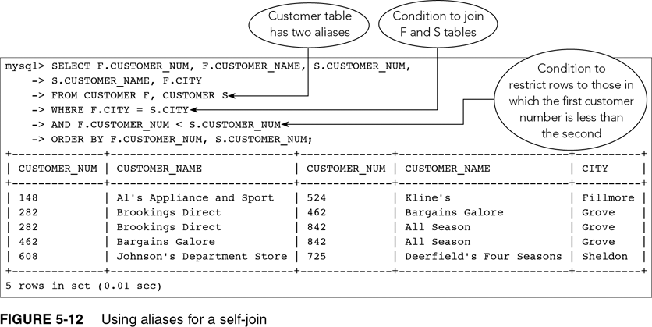
Joining a Table to Itself (continued)

Slide 21
Using a Self-Join on a Primary Key
Can create a self-join that involves primary key of table
List table twice in FROM clause with aliases; same as previous self-join example

Slide 22
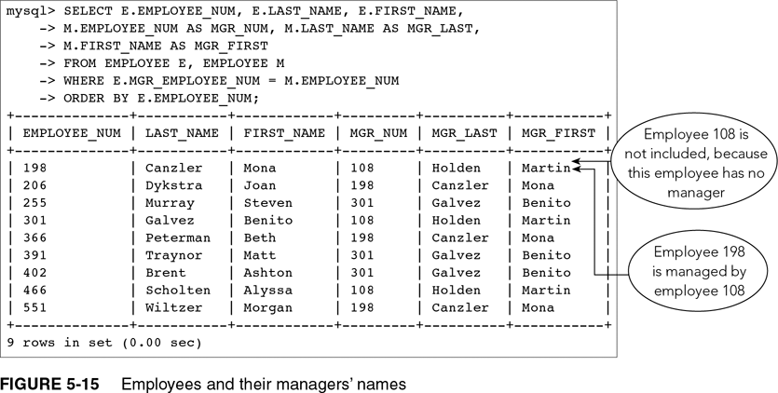
Using a Self-Join on a Primary Key (continued)

Slide 23
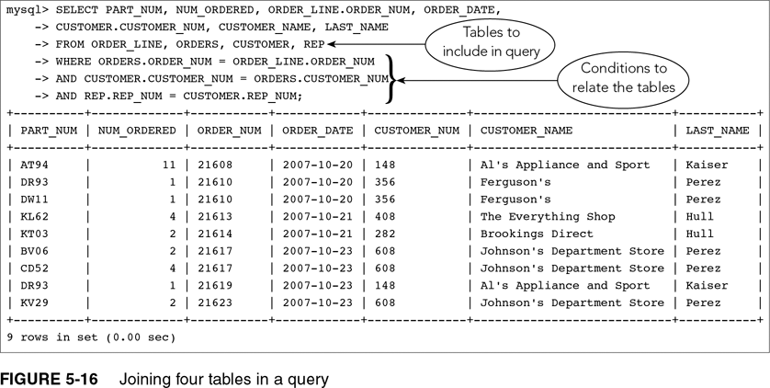
Joining Several Tables

Slide 24
Constructing a Detailed Query
In SELECT clause list all columns to display
Qualify any column names if needed
In FROM clause list all tables
Include tables used in the WHERE clause, even if they are not in the SELECT clause

Slide 25
Constructing a Detailed Query (continued)
Take one pair of related tables at a time
Indicate in WHERE clause the condition that relates tables
Join conditions with AND operator
Include any additional conditions in WHERE clause
Connect them with AND operator

Slide 26
Set Operations
The union of two tables is a table containing every row that is in either the first table, the second table, or both tables
Use UNION operator
Tables must be union compatible, that is, same number of columns and corresponding columns have identical data types and lengths

Slide 27
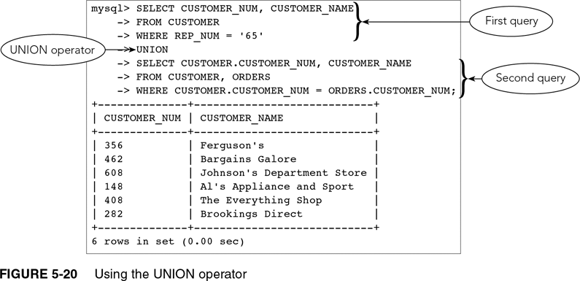
Set Operations (continued)

Slide 28
Set Operations (continued)
Intersection of two tables is a table containing all rows that are in both tables
Uses the INTERSECT operator
Not supported by MySQL
Use an alternate approach

Slide 29
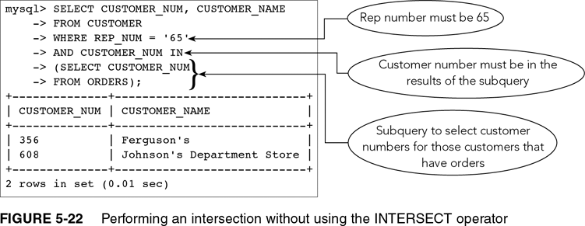
Set Operations (continued)

Slide 30
Set Operations (continued)
Difference of two tables is a table containing set of all rows that are in first table but not in second table
Uses the MINUS operator
Not supported by MySQL
Use an alternate approach

Slide 31
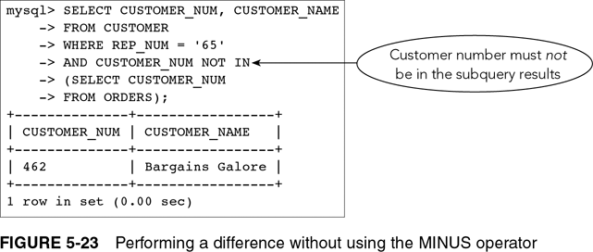
Set Operations (continued)

Slide 32
ALL and ANY
ALL operator: condition is true only if it satisfies all values
ANY operator: condition is true only if it satisfies any value
Precede subquery with appropriate operator

Slide 33
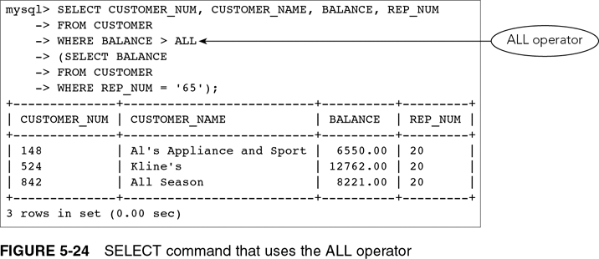
ALL and ANY (continued)

Slide 34
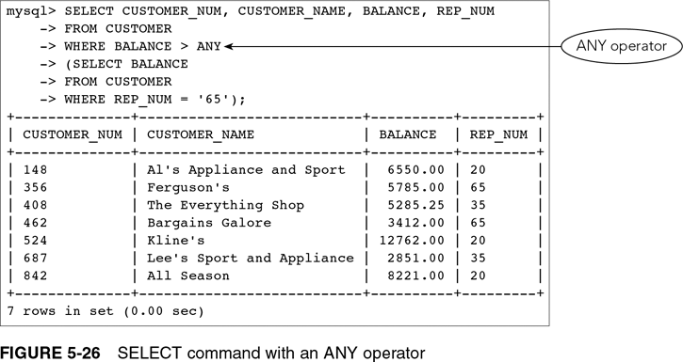
ALL and ANY (continued)

Slide 35
Special Operations
Inner join: compares the tables in FROM clause and lists only those rows that satisfy condition in WHERE clause
Outer Join: lists all rows from one of the tables in a join, regardless of matching

Slide 36
Outer Join
Left outer join: all rows from the table on the left (listed first in the query) will be included; matching rows only from the table on the right will be included
Right outer join: all rows from the table on the right will be included; matching rows only from the table on the left will be included
Full outer join: all rows from both tables will be included regardless of matches

Slide 37
Product
Product (Cartesian product) of two tables: combination of all rows in first table and all rows in second table
Omit WHERE clause to form a product

Slide 38
Summary
Join tables with alternate approaches
A subquery can contain another subquery
Use an alias to simplify SQL command as well to create self join

Slide 39
Summary (continued)
UNION, INTERSECT, MINUS set operations
ALL and ANY operators
Types of joins (inner and outer)
Cartesian product

